Slide 1
Data Visualization
Misleading visuals

Slide 2

Misleading axes
It appears that the welfare problem is spiraling out of control.
But note where the y-axis starts!
https://www.statisticshowto.com/probability-and-statistics/descriptive-statistics/misleading-graphs/
Notes:
US Today

Slide 3

Wrong data
The weights of the categories do not add up
http://flowingdata.com/2009/11/26/fox-news-makes-the-best-pie-chart-ever/

Slide 4
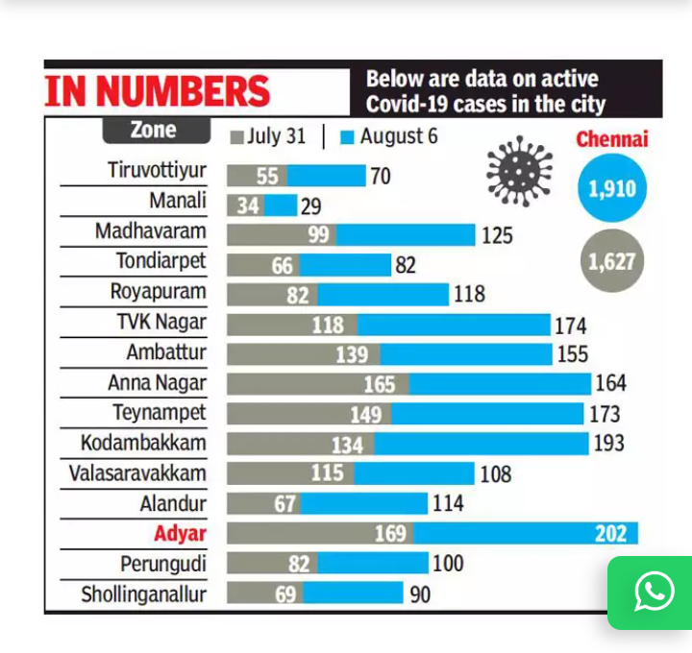
Inappropriate chart type
It is difficult to compare the two datasets using the stacked bar chart.
Bar chart with two series of columns would be better.
Notes:
ToI

Slide 5
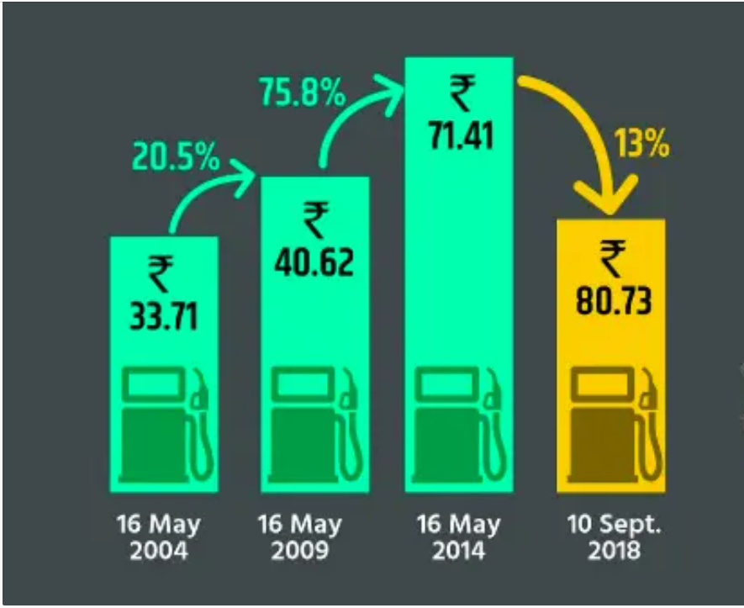
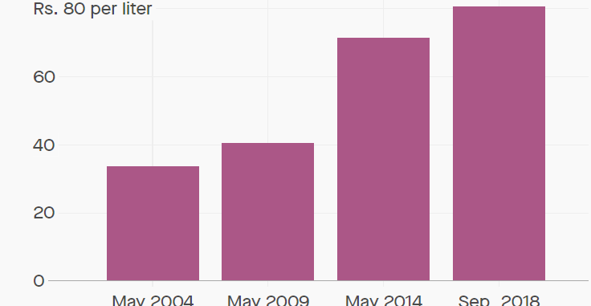
Incorrect bar chart
%increase in petrol prices
An arrow points downward to Sept data point, however there is a positive change to the price.
However, the %increase has reduced for Sept.
Accurate chart might be
https://qz.com/india/1388030/indias-bjp-peddled-a-prime-example-of-chartjunk-to-its-millions-of-followers/
https://qz.com/india/1388030/indias-bjp-peddled-a-prime-example-of-chartjunk-to-its-millions-of-followers/

Slide 6
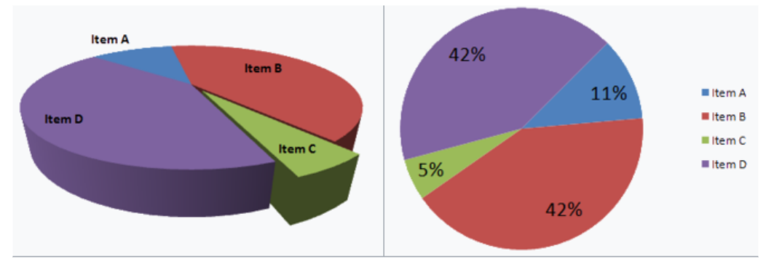
Misleading 3D Pie Chart
The slices closer to you will appear larger than those further away.
Compare Item A and Item C in both the graph
https://www.noigroup.com/noijam/how-to-spot-a-misleading-graph/
Notes:
Among other things, the human eye is sensitive to the area occupied by a given color. There are better attributes — for example our eyes are more sensitive to position, which is why many people say bar charts easier to read.
Going back to 3D pie charts, the color of the sides usually match with the color on the top, so the total area on the screen or page occupied by the colors in front are larger that the area of the wedge. Because there's more area painted with the front colors, your brain sees them as more dominant and bigger than the actual proportion.
The same effect happens even more in 3D exploding charts. Any wedge that is set apart from the rest of the chart is drawn with exposed sides, which exaggerates the wedges, even more so if the exposed sides are perpendicular to the viewing vector. The exploded wedge can appear in in front of the other parts of pie that are in the back, obscure them and cause those parts to show less color.
Furthermore, if the 3D uses a perspective projection, then the area occupied by the part of the pie in the front is exaggerated by the mathematics of projections.

Slide 7
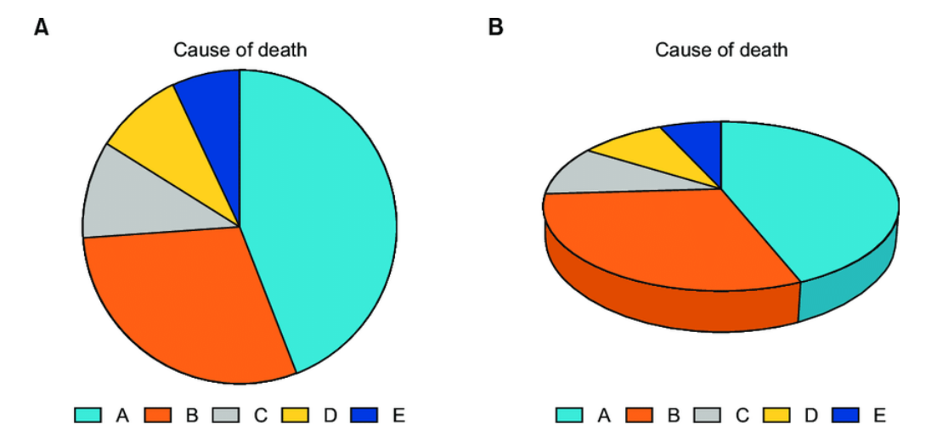
Misleading 3D Pie Chart..
A and B look quite similar in the 3D graph!
In, J., & Lee, S. (2017). Statistical data presentation. Korean journal of anesthesiology, 70(3), 267.

Slide 8
Thank you

Slide 9
Tutorial 1.2 Creating a dashboard

